Slide 1
C/C++ Programming in a UNIX Environment
CS 3376
Bhanu Kapoor, PhD
Department of Computer Science University of Texas, Dallas, TX bhanu.kapoor@utdallas.edu
Lecture Notes 06

Slide 2
Reading for Week 04
Chapter 2 and 3 of A Practical Guide to Linux® Commands, Editors, and Shell Programming, Third Edition. Mark G. Sobell.
Chapter 2: Getting Started
Chapter 3: The Utilities

Slide 3
Agenda
Getting Started with Linux
The Utilities

Slide 4
Agenda
Getting Started with Linux
The Utilities

Slide 5
Utilities
Objectives
List special characters and methods of preventing the shell from interpreting these characters
Use basic utilities to list files and display text
files
Copy, move, and remove files
Search, sort, print, and compare text files
String commands together using a pipeline
Compress, decompress, and archive
Locate utilities on the system
Display information about users
▪ Communicate with other users

Slide 6
Special Characters
Avoid using any of the following characters in a filename
□ & ; | * ? ' " ' [ ] ( ) $ < > { } # / \ ! ~
Whitespace
Backslash
Single quotation marks
$ echo 'xxxxxxCONTROL-U‘
$ echo xxxxxxCONTROL-V CONTROL-U \*
$ echo xxxxxxCONTROL-V CONTROL-U | od
-c

Slide 7
Basic Utilities
□ $ ls
practice
$ cat practice
This is a small file that I created with a text editor.
$ rm practice
$ ls
$ cat practice
cat: practice: No such file or directory
cat: Displays a Text File
rm: deletes a file, rm –i safer way
less: display one screen page at a time

Slide 8
Basic Utilities
hostname: Displays the System Name
cp: Copies a File
$ ls
memo
$ cp memo memo.copy
$ ls
memo memo.copy
$ cp –i orange orange.2
cp: overwrite 'orange.2'? Y
mv: Changes the Name of a File
mv existing-filename new-filename

Slide 9
Basic Utilities
lpr: Prints a File
$ lpr report
$ lpr -P mailroom report
$ lpr -P laser1 05.txt 108.txt 12.txt
$ lpq
$ lprm 86
grep: Searches for a String
$ grep 'credit' memo

Slide 10
Basic Utilities
head: Displays the Beginning of a File
$ head months
$ head -1 months
tail: Displays the End of a File
$ tail -5 months
sort: Displays a File in Order
$ sort months
uniq: Removes Duplicate Lines from a File
$ uniq dups

Slide 11
Basic Utilities
diff: Compares Two Files
$ diff -u colors.1 colors.2
file: Identifies the Contents of a File
$ file memo zach.jpg
memo: ASCII text
zach.jpg: JPEG image data, ... resolution (DPI), 72 x 72
| (Pipeline): Communicates Between Processes
$ sort months | head -4
$ ls | wc -w

Slide 12
Basic Utilities
echo: Displays Text
$ ls
memo memo.0714 practice
$ echo Hi
Hi
$ echo This is a sentence.
This is a sentence.
$ echo star: *
star: memo memo.0714 practice
$ echo 'My new file.' > myfile
$ cat myfile
My new file.

Slide 13
Basic Utilities
□ date: Displays the Time and Date
$ date
Tue Apr 3 10:14:41 PDT 2012
$ date +"%A %B %d"
Tuesday April 03
□ script: Records a Shell Session
$ script
Script started, file is typescript
$ ls -l /bin | head -5
-rwxr-xr-x. 1 root root 123 02-07 $ exit
exit
Script done, file is typescript

Slide 14
Compressing and Archiving Files
gzip: Compresses a File
tar: Packs and Unpacks Archives
$ ls -l g b d
-rw-r--r--. 1 zach other 1178 08-20 14:16 b
-rw-r--r--. 1 zach zach 3783 08-20 14:17 d
-rw-r--r--. 1 zach zach 1302 08-20 14:16 g
$ tar -cvf all.tar g b d
g b d
$ ls -l all.tar
-rw-r--r--. 1 zach zach 9728 08-20 14:17 all.tar
$ tar -tvf all.tar
-rw-r--r-- zach /zach
-rw-r--r-- zach /other
-rw-r--r-- zach /zach
1302 2012-08-20 14:16 g
1178 2012-08-20 14:16 b
3783 2012-08-20 14:17 d

Slide 15
Uncompress
□ $ ls -l mak*
-rw-r--r--. 1 sam pubs 1712747 04-05 10:43 make-3.82.tar.gz
$ gunzip mak*
$ ls -l mak*
-rw-r--r--. 1 sam pubs 6338560 04-05 10:43 make-3.82.tar
$ tar -xvf mak*
make-3.82/
make-3.82/vmsfunctions.c make-3.82/getopt.h
make-3.82/make.1
...
make-3.82/README.OS2
make-3.82/remote-cstms.c
$ gunzip -c make-3.82.tar.gz | tar -xvf –
tar -xvzf make-3.82.tar.gz

Slide 16
Locating Utilities
which and whereis: Locate a Utility
$ which tar
/bin/tar
$ whereis tar
tar: /bin/tar
/usr/share/man/man1/tar.1.gz

Slide 17
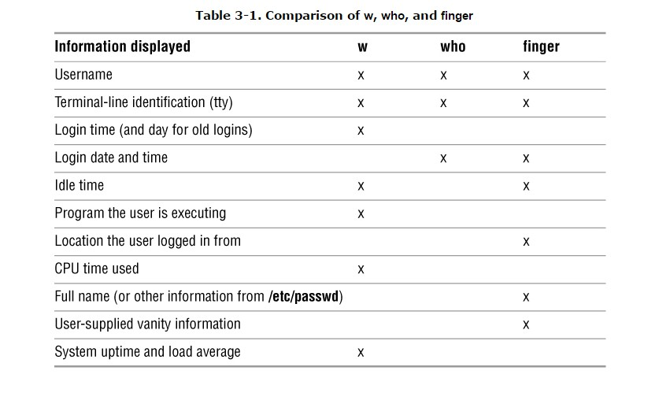
User and System Infromation

Slide 18
User and System Information
who: Lists Users on the System
$ who
$ who am I
finger: Lists Users on the System
$ finger
$ finger Simpson
uptime: Displays System Load and Duration Information
$uptime
w: Lists Users on the System

Slide 19
Communications
write: Sends a Message
$ write max
Hi Max, are you there? O
mesg: Denies or Accepts Messages
$ mesg y
$ write max

Slide 20
Questions
Which commands can you use to determine who is logged in on a specific terminal?
What happens when you give the following commands if the file named done already exists?
$ cp to_do done
$ mv to_do done
How can you find out which utilities are available on your system for editing files?
What happens when you use diff to compare two files?
What is the result of giving the which utility the name of a command that resides in a directory that is not in your search path?
Experiment by calling the file utility with the names of files in one of your directories. How many different types of files are there?
Use ls –l to determine the sizes of the files in your directory
How would you create a zipped tar file for one of your directories?

